Slide 1



SP6T Control System
MEMSDuino
Lafe Spietz
NIST
2024

Slide 2
Abstract
This system uses the MEMSDuino to control the SP6T switches available from CryoElec.
MEMSDuino

Slide 3
Bill of materials
Wood Board
Custom metal box
Brass screws to fasten box to board
Steel screws to hold electronics down
3d printed standoffs and thread inserts
M-M short Jumpers
F-M long jumpers
SP6T switch from CryoElec
DB 25 socket connector
4-40 hex standoffs
MicroD to dual nanoD breakout board and bracket

Slide 4
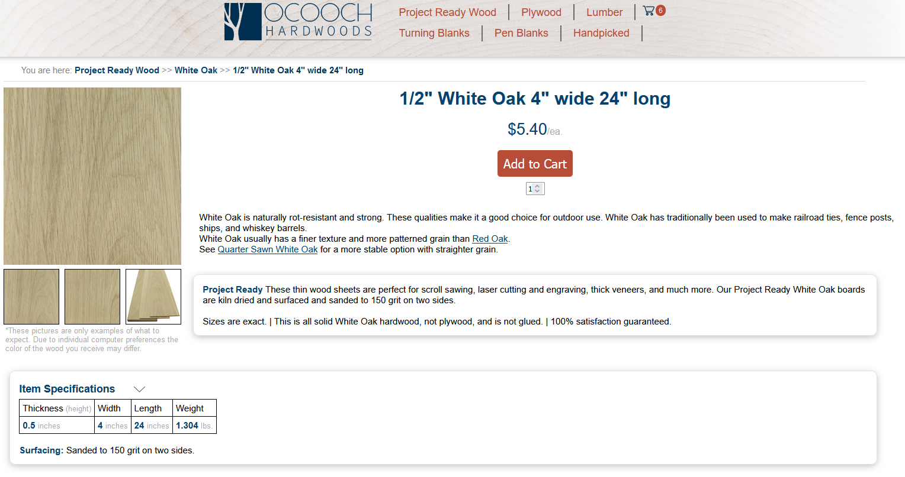
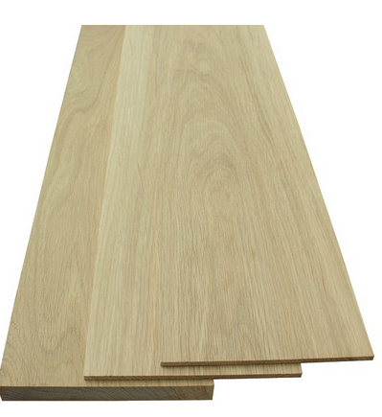
4”x24”x0.5” White Oak Boards
https://ocoochhardwoods.com/detail/?i=124wo

Slide 5
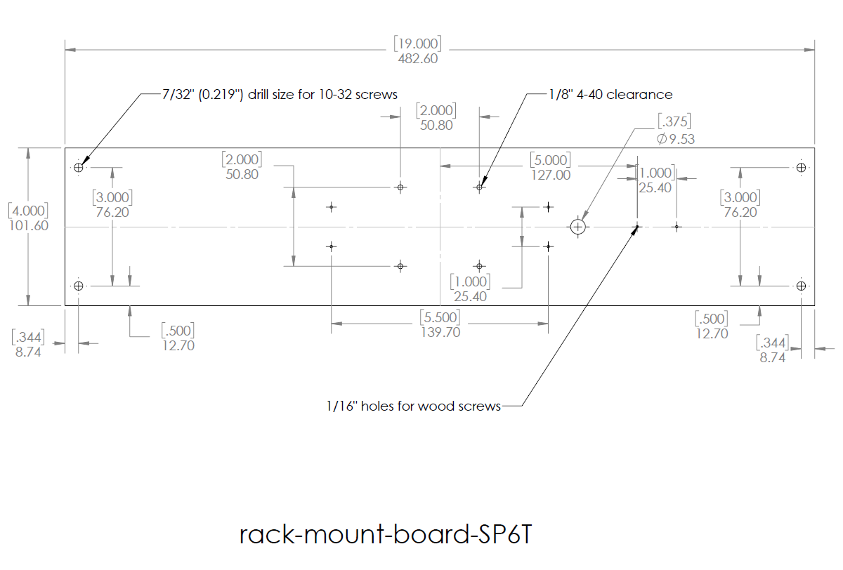

Slide 6
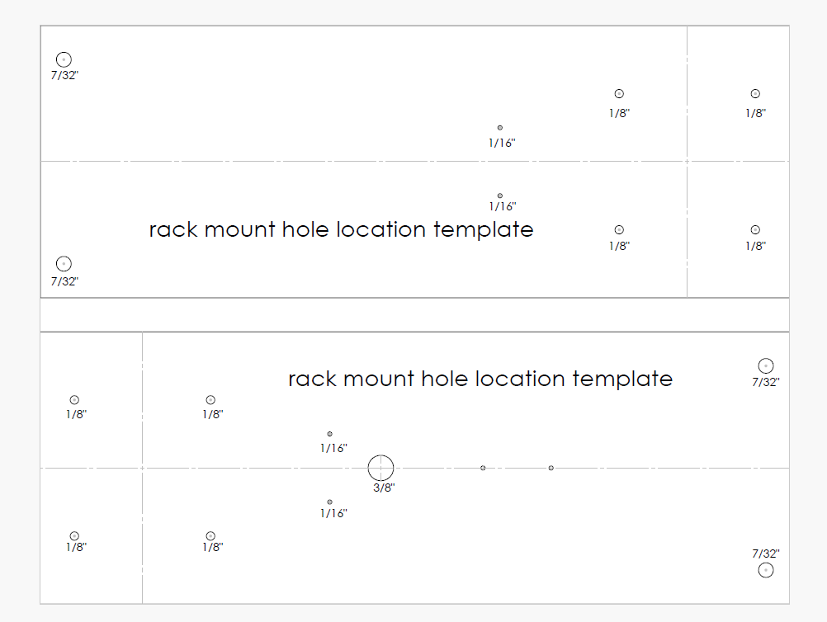
Print out template at 1:1 scale to trace hole locations to wood board

Slide 7
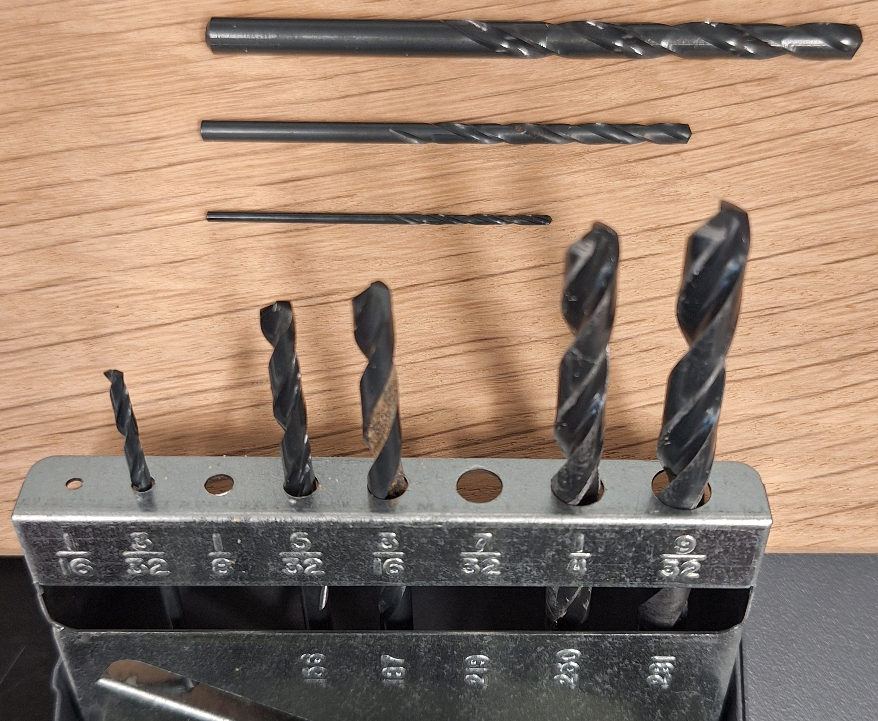
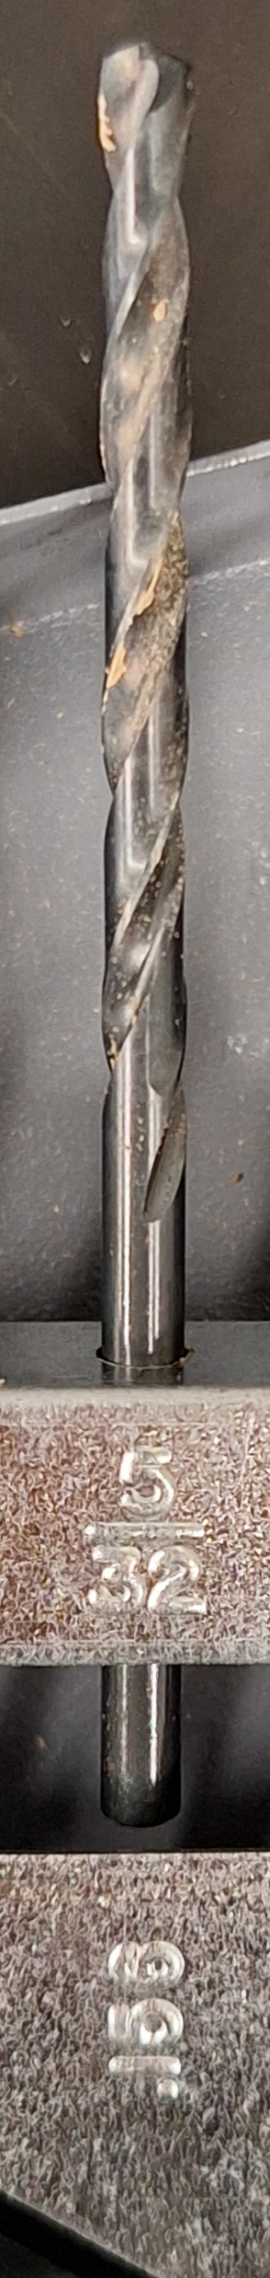
Drill bits to use
1/16” bit: pilot holes and holes for wood screws.
1/8” bit: through holes for 4-40 screws
7/32” for 10-32 thumb screw clearance holes
5/32” to mill out slot for 4 wire header cable

Slide 8
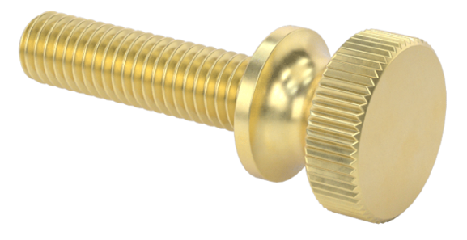
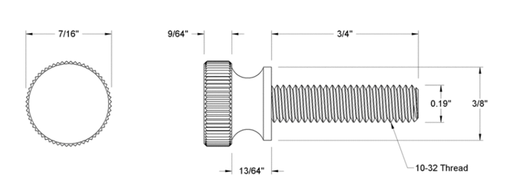
Knurled Brass Thumb Screws to Mount in Panel
https://www.mcmaster.com/92421A645/

Slide 9
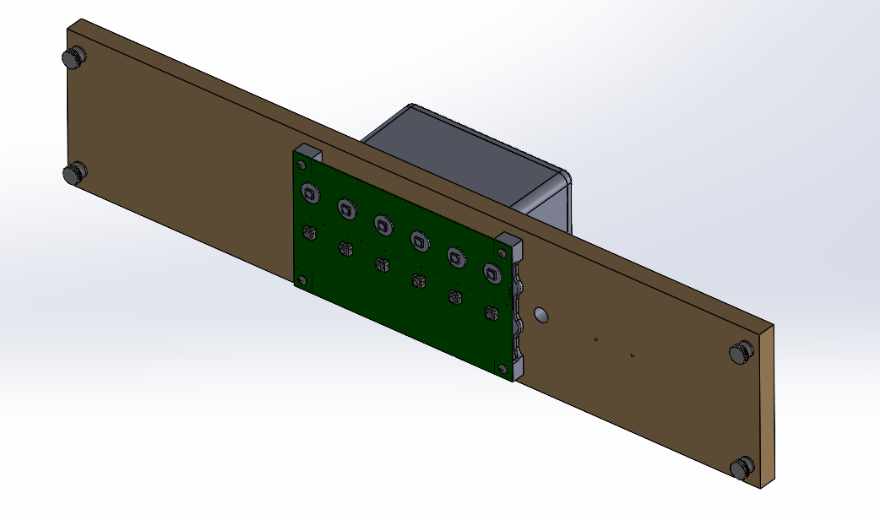
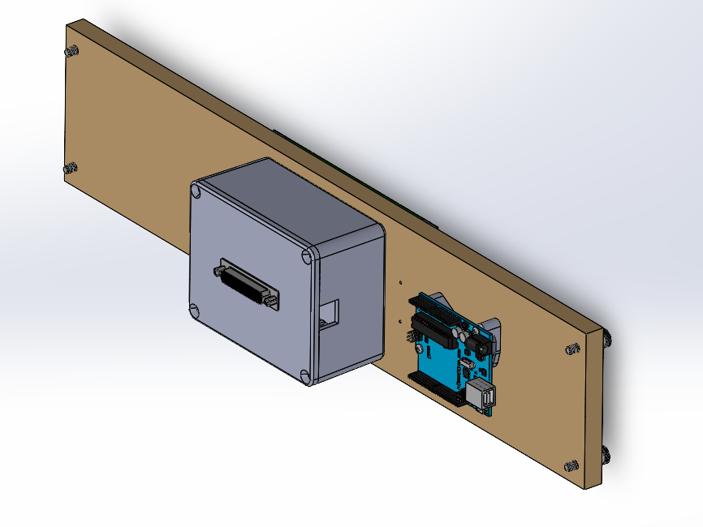

Slide 10
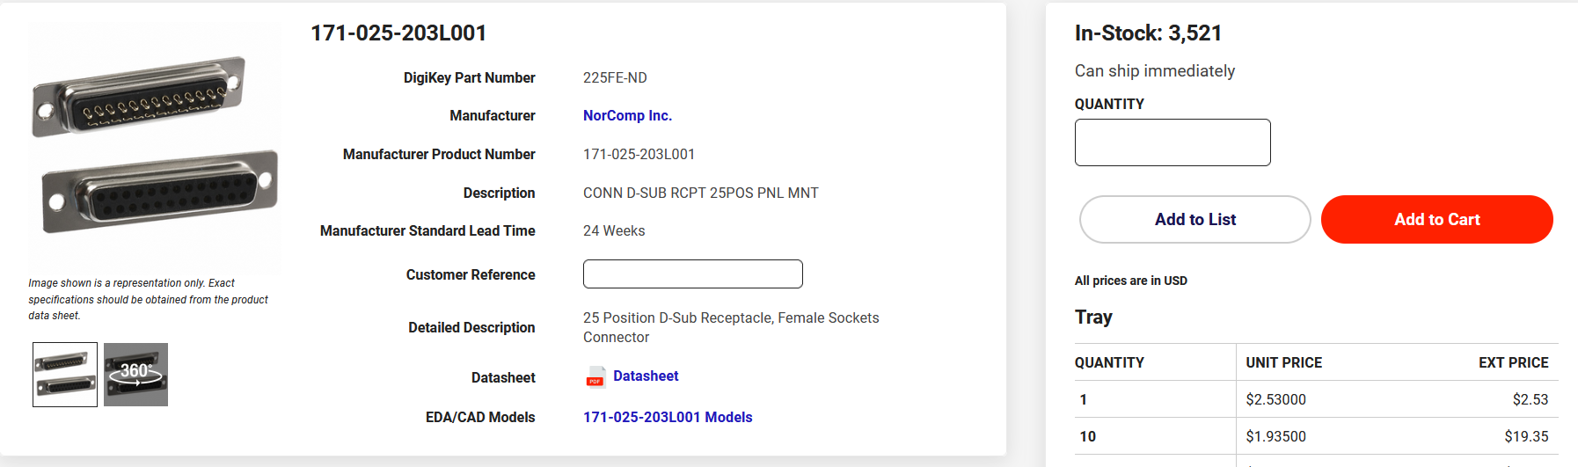
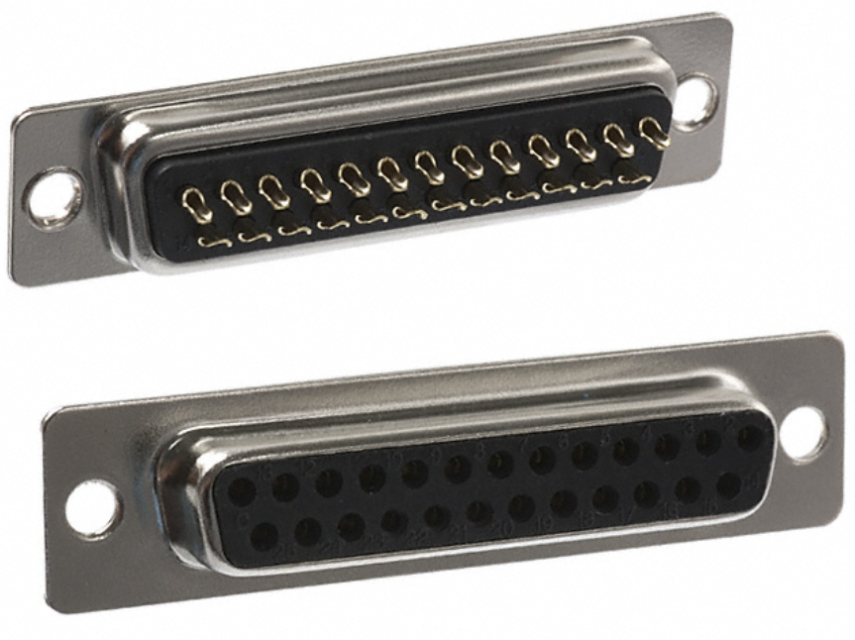
X1
https://www.digikey.com/en/products/detail/norcomp-inc/171-025-203L001/858144

Slide 11
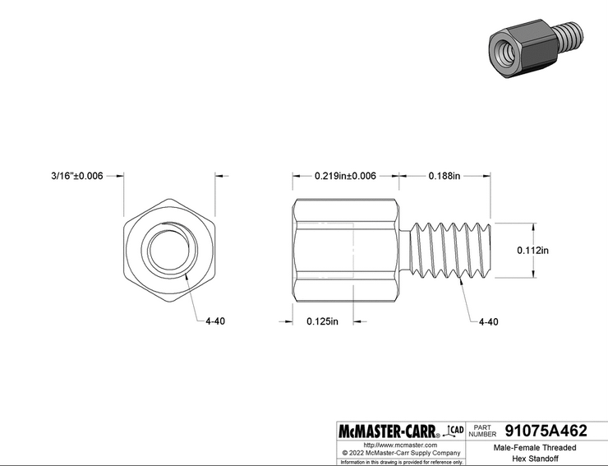
X2
https://www.mcmaster.com/91075A462/

Slide 12
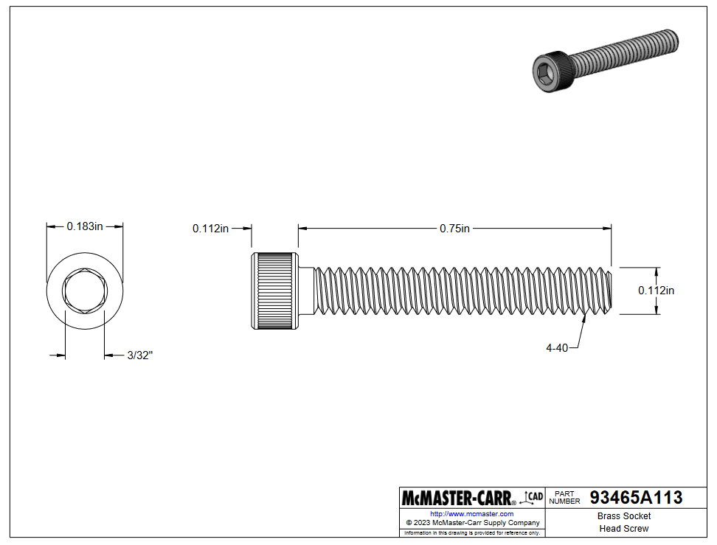
X4
https://www.mcmaster.com/93465A113/

Slide 13
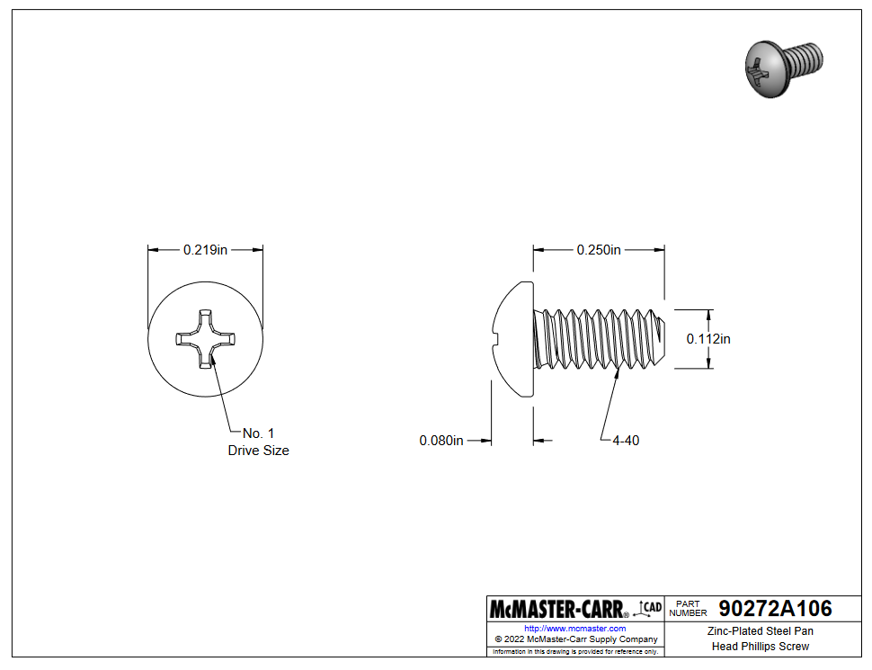
X7
https://www.mcmaster.com/90272A106/

Slide 14
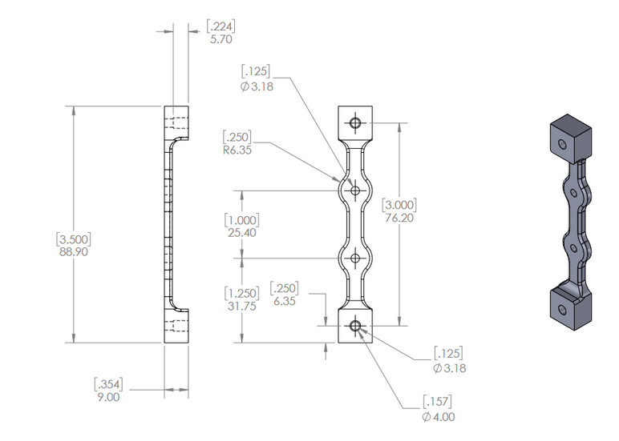
X2
front-panel-edge-bracket.STL

Slide 15
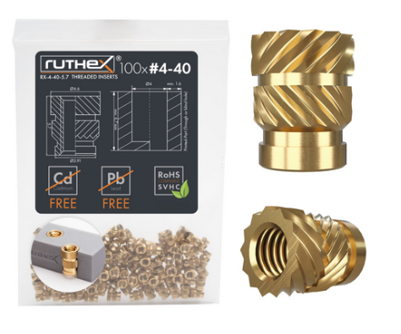
X7
https://www.3djake.com/ruthex/threaded-insert-4-40-unc-100-pieces

Slide 16
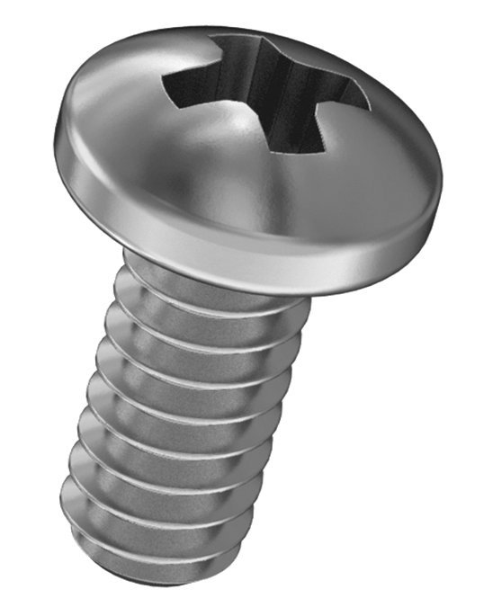
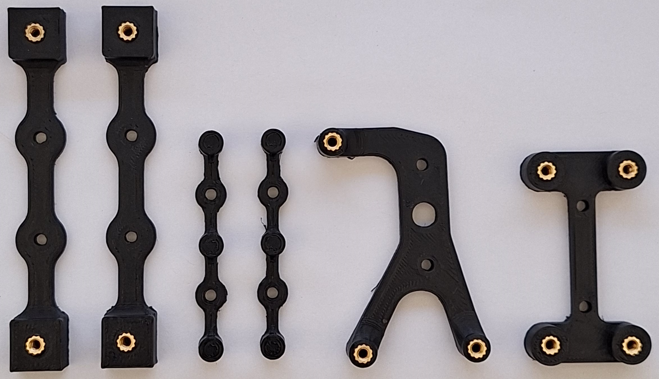

Slide 17
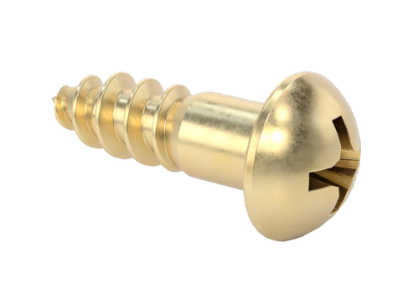
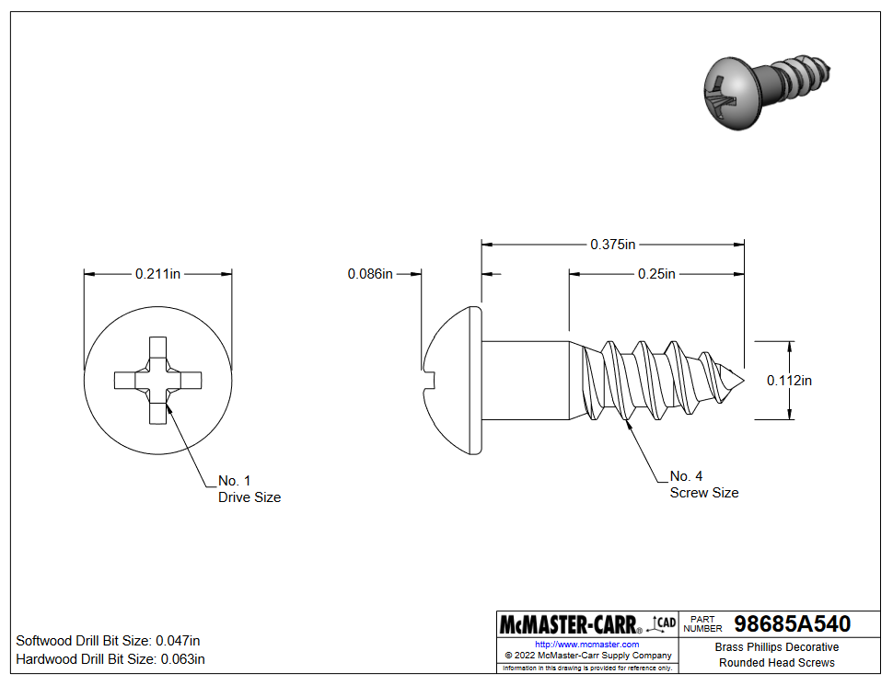
X6
https://www.mcmaster.com/98685A540/

Slide 18
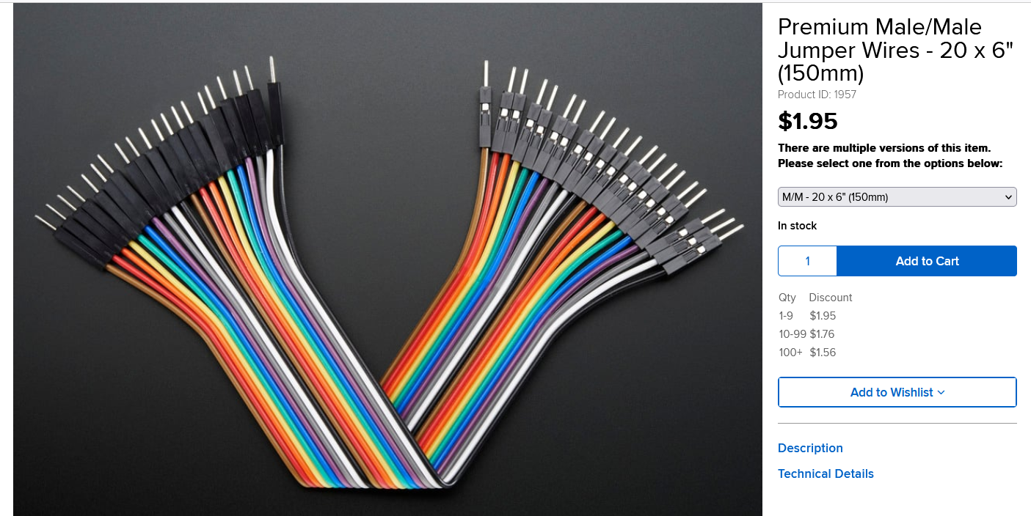
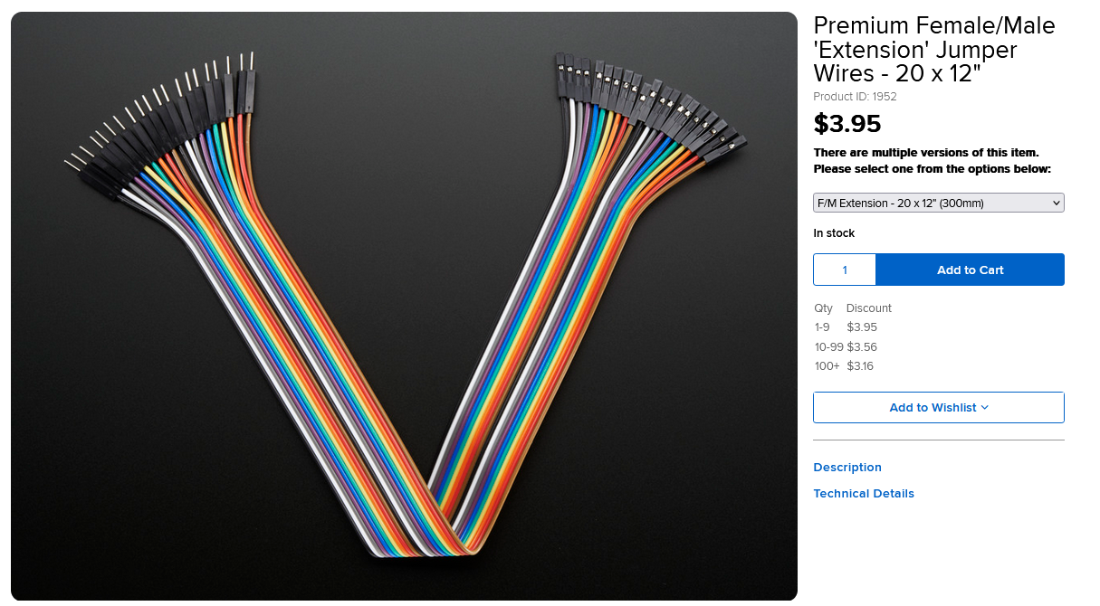
https://www.adafruit.com/product/1957
https://www.adafruit.com/product/1952

Slide 19
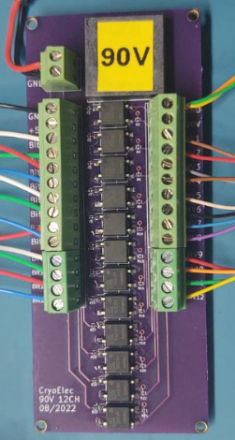
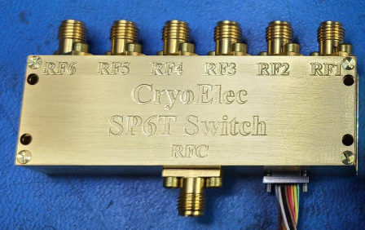
https://www.cryoelec.com/products/cryoswitchsp6t

Slide 20
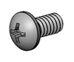
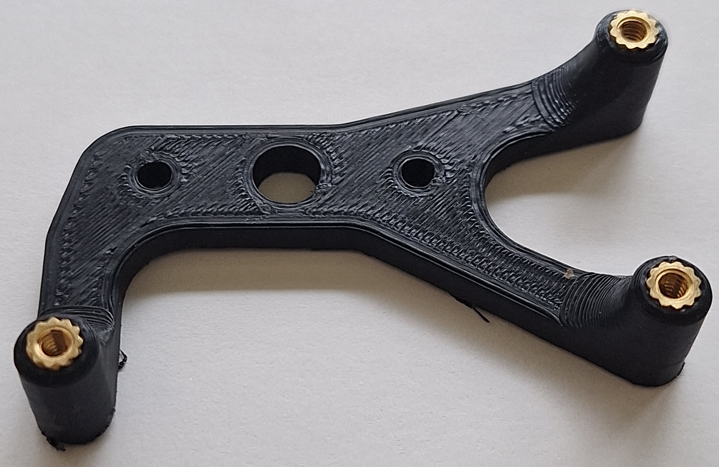
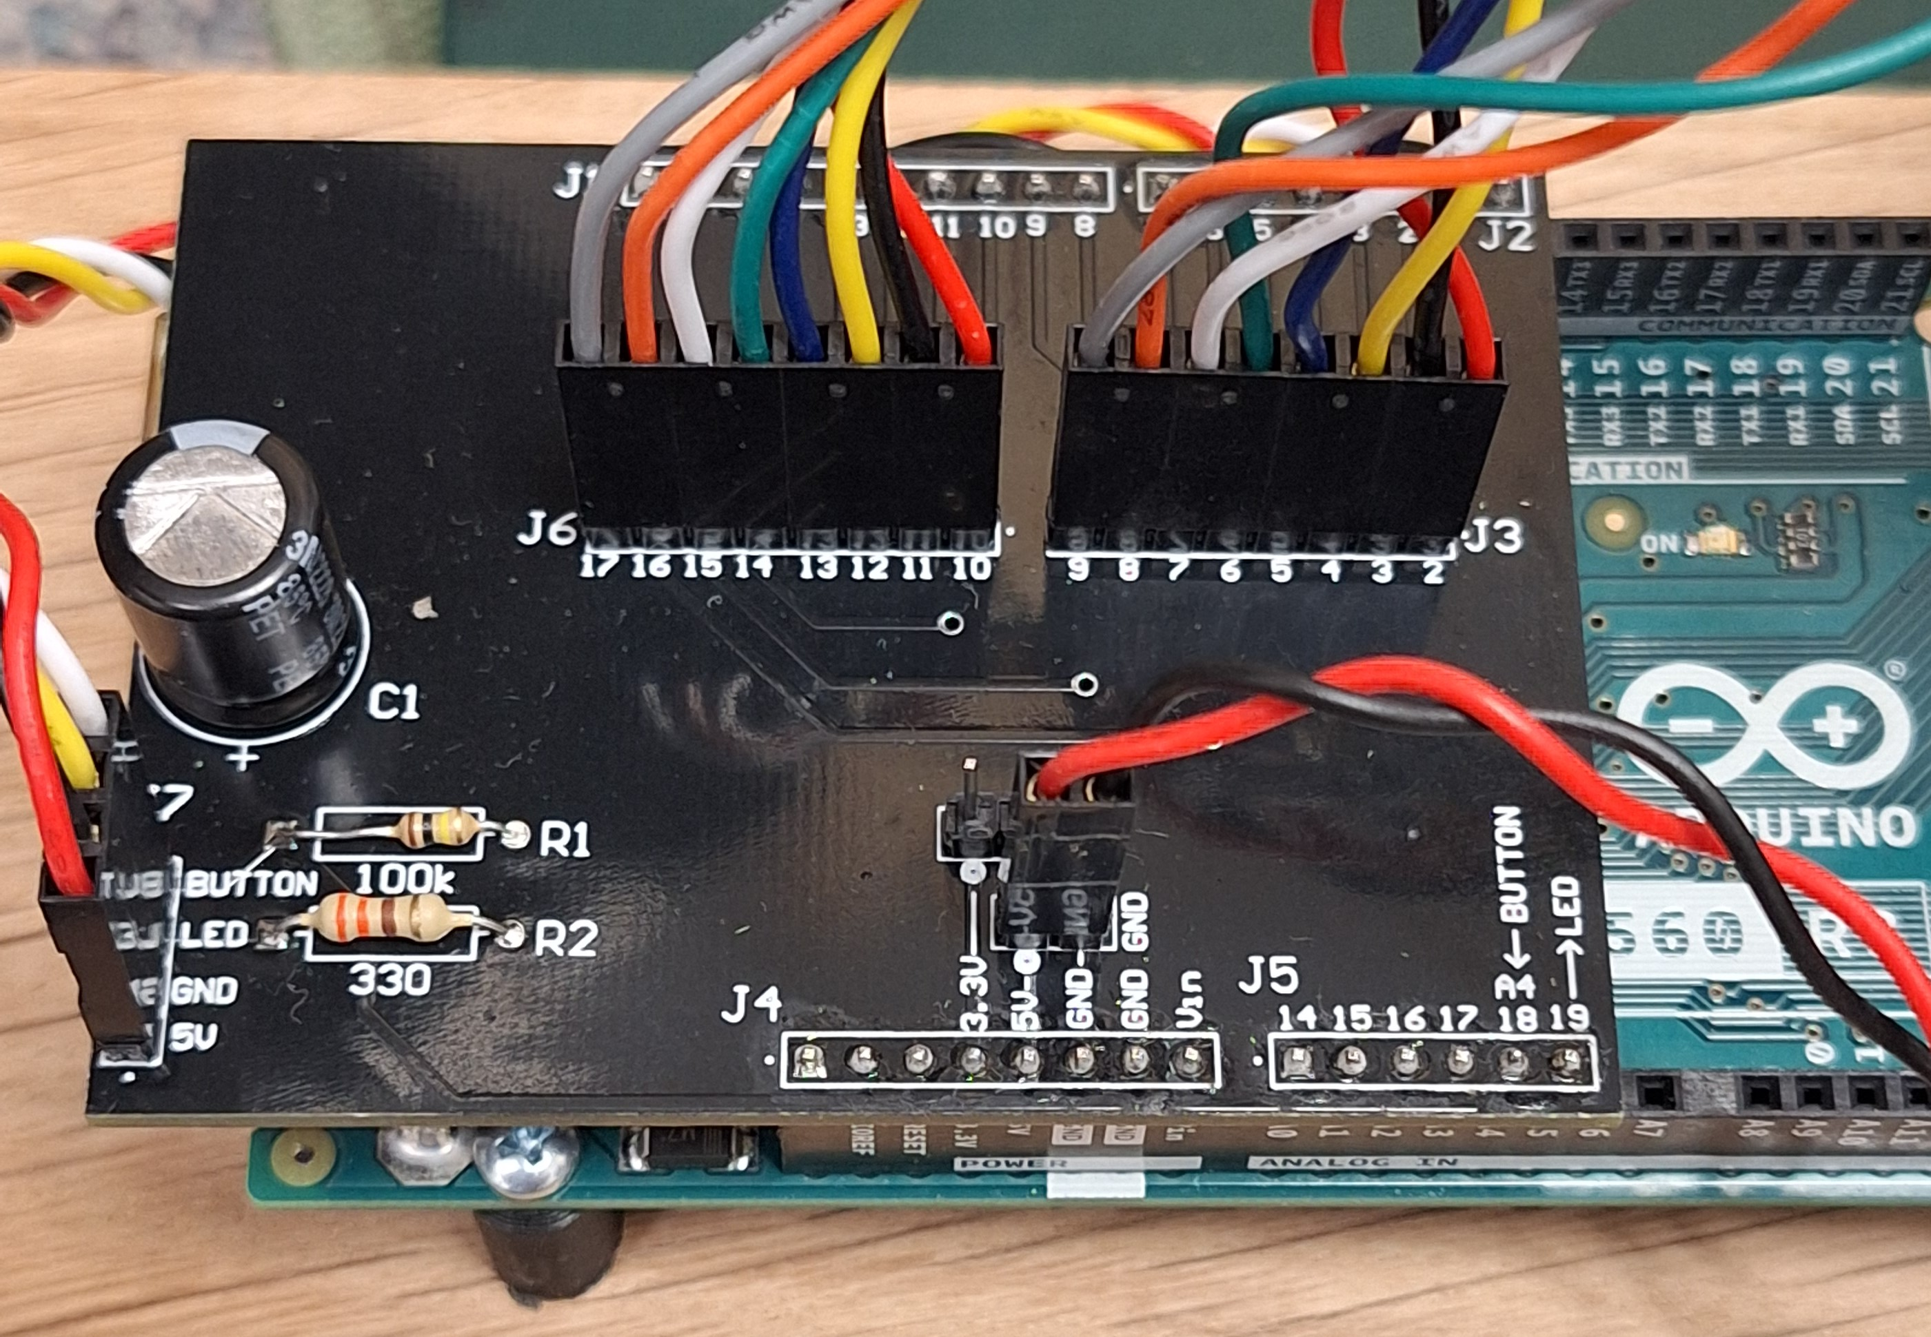
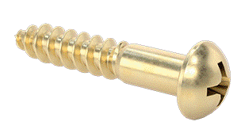

Slide 21
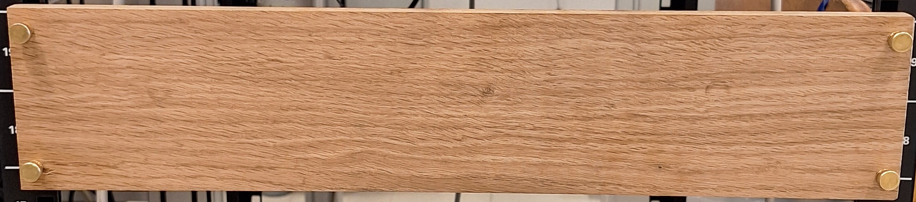
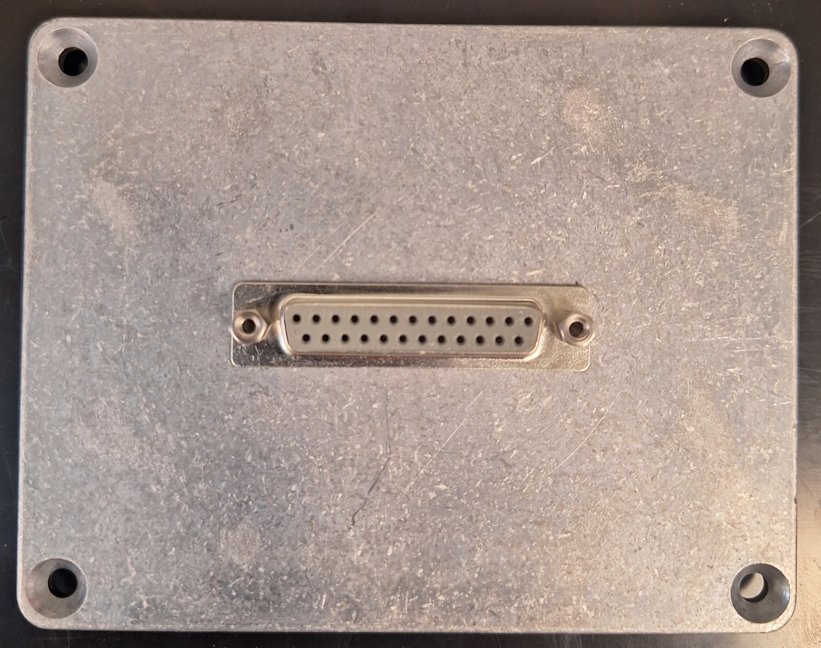
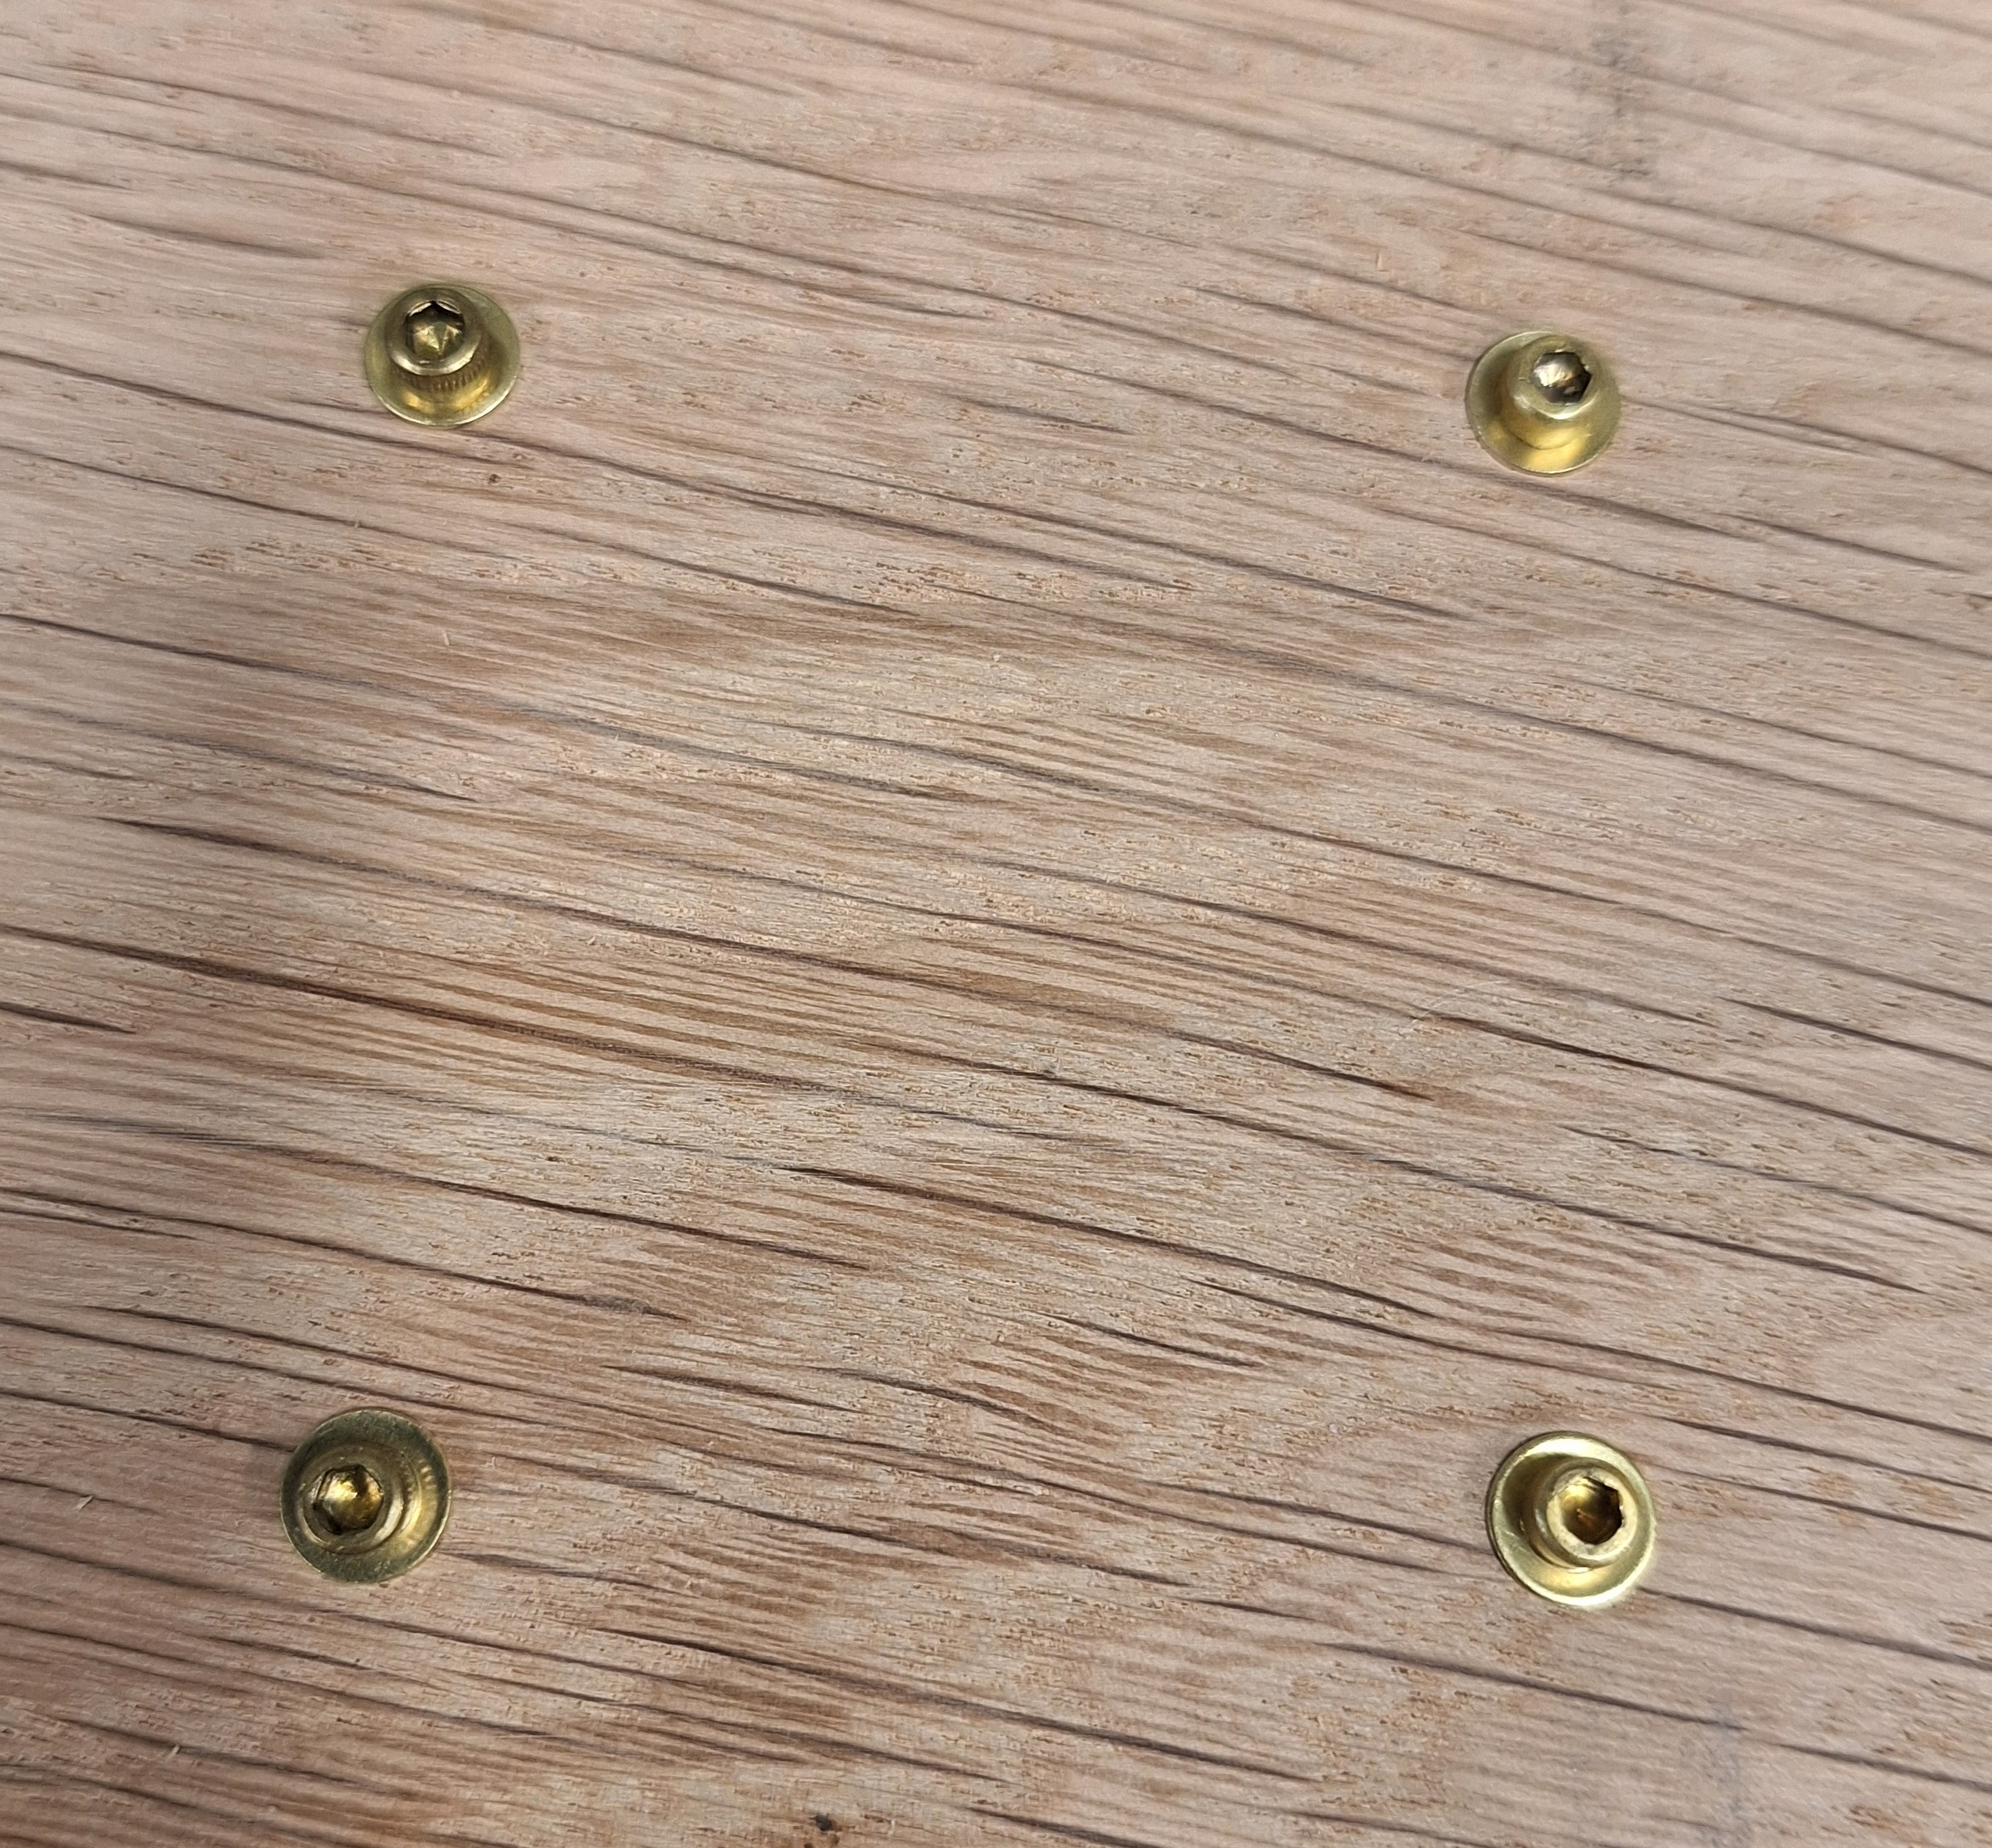

Slide 22
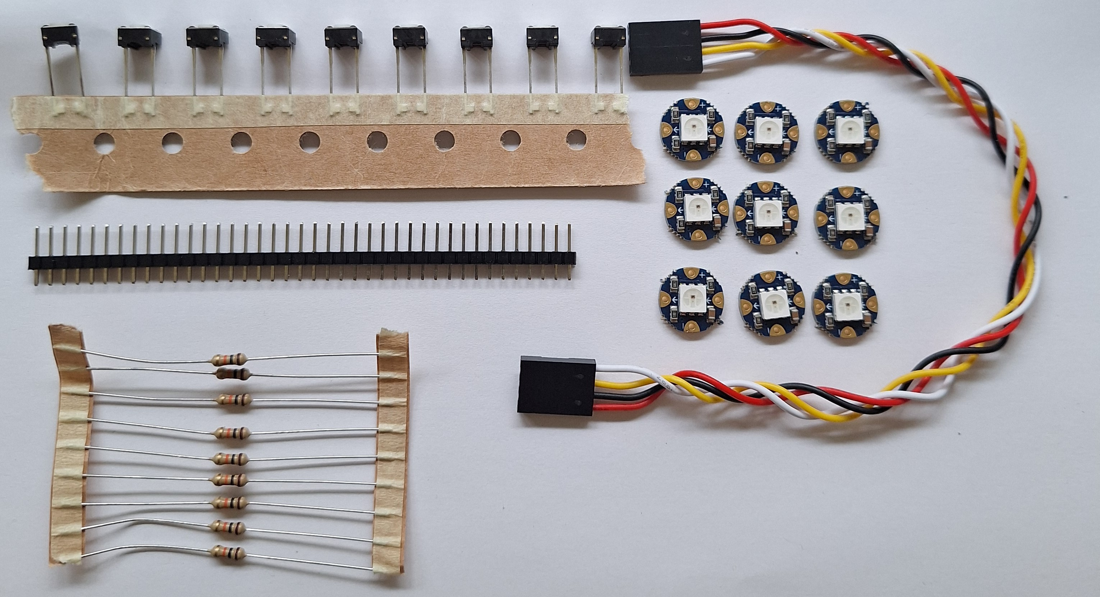
Order Components
4 Wire Header cable, 6” long x1
Button x6
https://www.amazon.com/ZYAMY-Dupont-Connector-Multicolor-Breadboard/dp/B0789F523N/
https://www.digikey.com/en/products/detail/e-switch/TL59NF160Q/390533
10 kOhm axial resistor x6
NeoPixel RGB programmable LED x6
https://www.digikey.com/en/products/detail/yageo/MFR-25FBF52-10K/13219
https://www.adafruit.com/product/1559
MEMSDuino

Slide 23
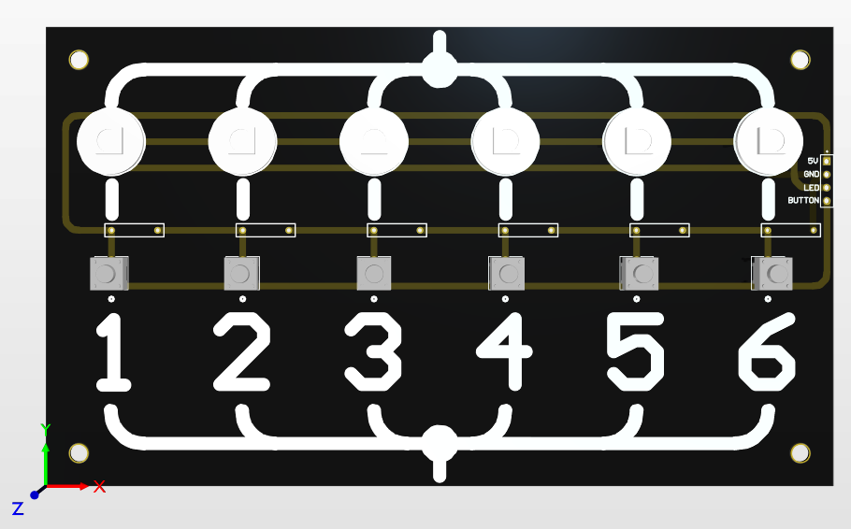
MEMSduino\PCB_files\6button-6neopixel-gerbers.zip
152.4 mm x 88.9 mm
Black solder mask, white silkscreen

Slide 24
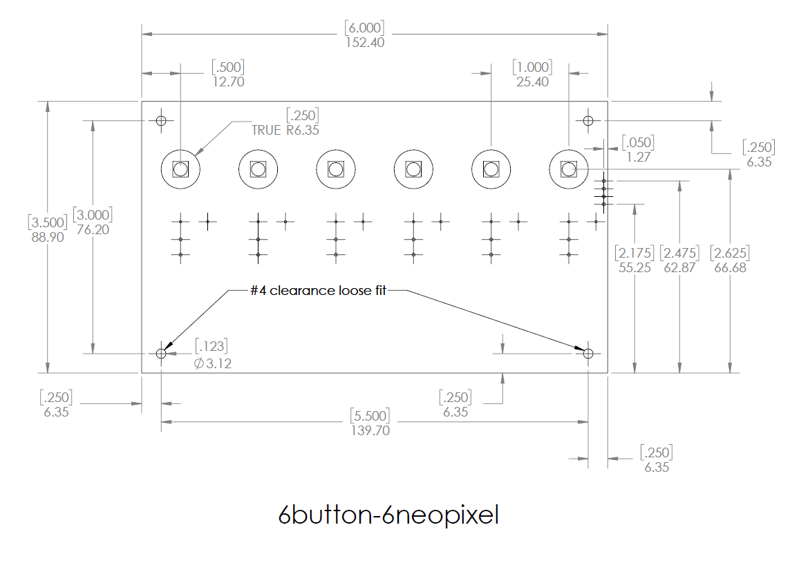
MEMSduino\PCB_files\6button-6neopixel-gerbers.zip

Slide 25
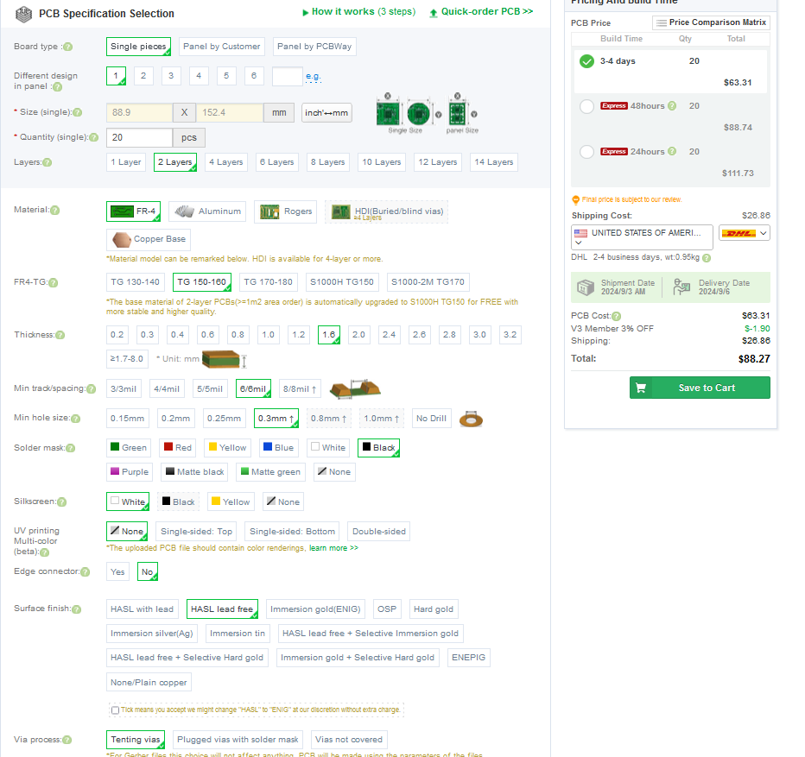
Everything default but what is marked with red arrows
Pcbway.com

Slide 26
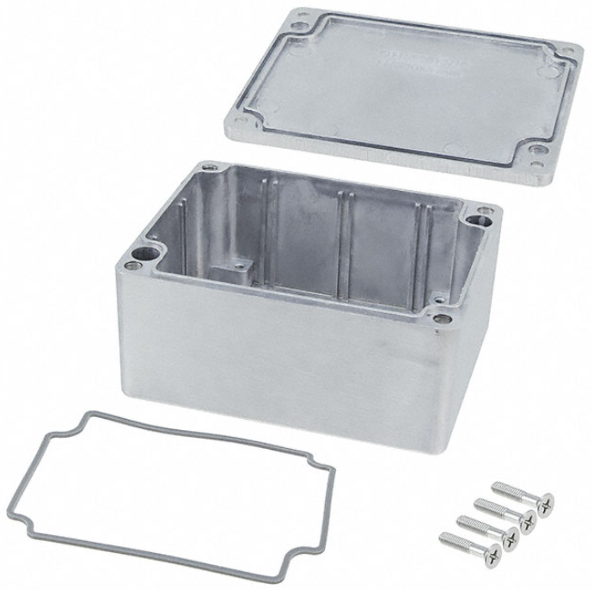
Bud AN-1304-A Diecast Aluminum Box
https://www.mouser.com/ProductDetail/Bud-Industries/AN-1304-A?qs=9qK3lZr%252Bi0J%2FETgT9O2KyQ%3D%3D

Slide 27
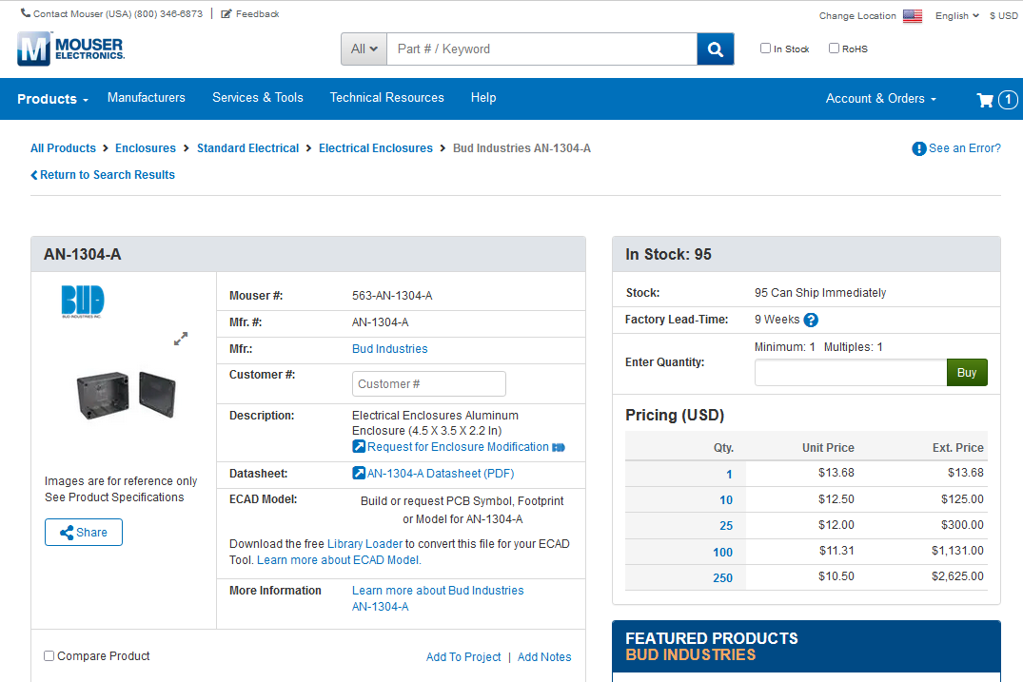
Bud AN-1304-A Diecast Aluminum Box
https://www.mouser.com/ProductDetail/Bud-Industries/AN-1304-A?qs=9qK3lZr%252Bi0J%2FETgT9O2KyQ%3D%3D

Slide 28
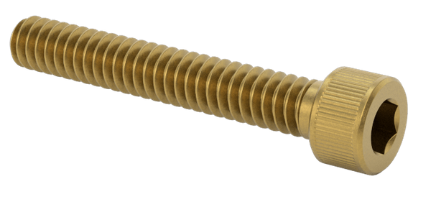
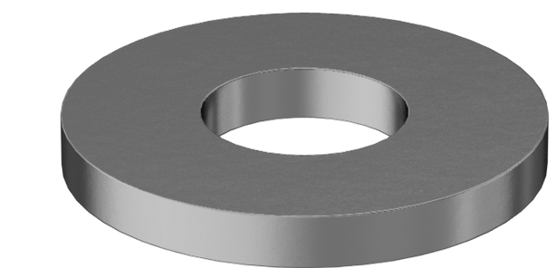
Use ¾” 4-40 screws to attach the main box to the wood board, with washers for each screw:
X4
Be sure to orient box so that hole for cables points towards Arduino.

Slide 29
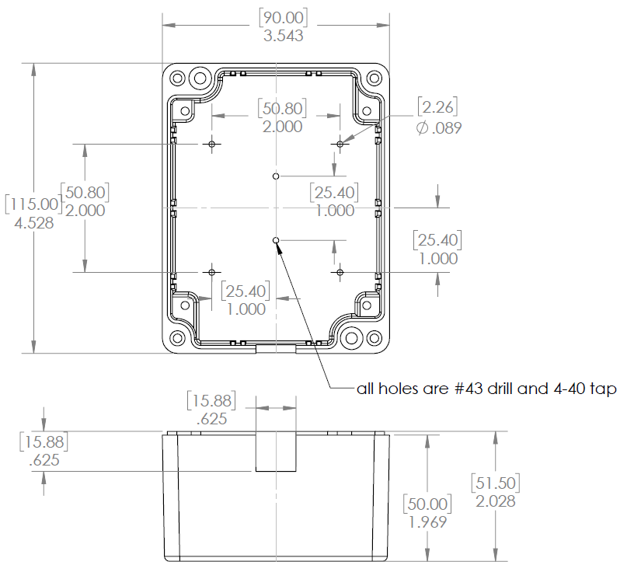
Modify or buy already-modified AN-1304-A box as follows:

Slide 30
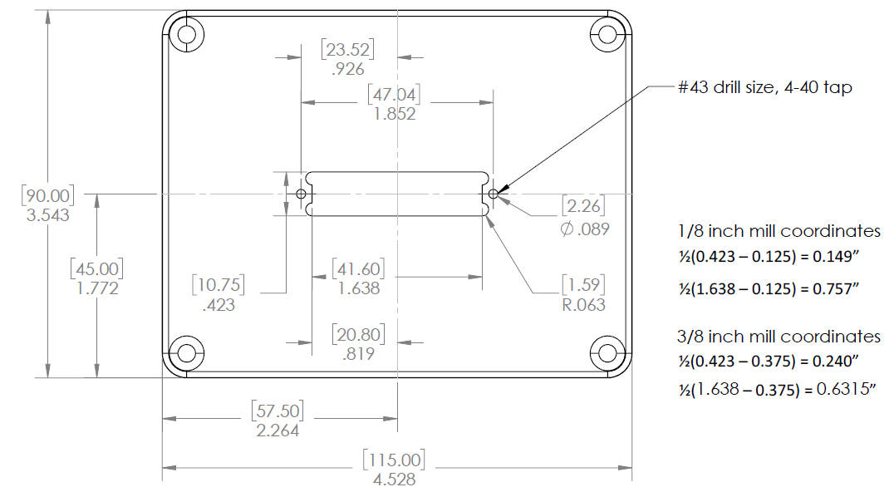
Modify or buy already-modified AN-1304-A lid as follows:

Slide 31
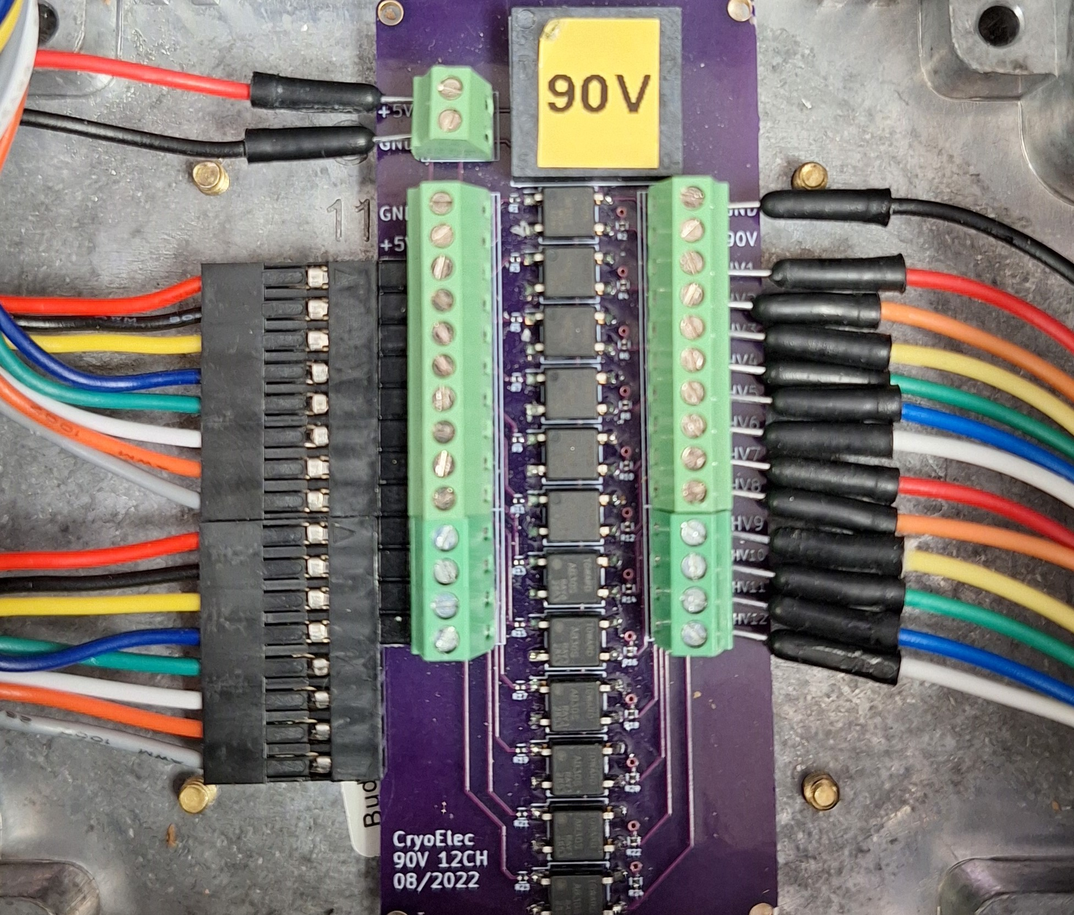
MEMSDuino

Slide 32
Conclusions:
MEMSDuino

